Slide 1
EECS 2500 Linear Data Structures
Lecture 16
Chapter 10 – Searching and Sorting – Part 1
Fall 2016
Dr. Larry G. Thomas – University of Toledo/LCCC

Slide 2
Welcome to EECS 2500
Pages of primary text in each chapter:
Ch. 1: 49 pp. (Getting Organized)
Ch. 2: 83 pp. (Abstract Data Types (ADTs))
Ch. 3: 80 pp. (The Stack ADT)
Ch. 4: 42 pp. (Recursion)
Ch. 5: 73 pp. (The Queue ADT)
Ch. 6: 75 pp. (The List ADT)
Ch. 7: 50 pp. (More Lists)
Ch. 8: 67 pp. (Binary Search Trees – skip)
Ch. 9: 48 pp. (Priority Queues, Heaps, and Graphs – skip)
Ch. 10: 67 pp. (Searching / Sorting Algorithms – partial)

Slide 3
Chapter Outline
10.1 – Sorting
10.2 – Simple Sorts - O(N²)
10.3 – O(N log₂ N) Sorts
10.4 – More Sorting Considerations
10.5 – Searching
10.6 – Hashing

Slide 4
Sorting (§10.1)
Putting an unsorted list of data elements into order – sorting - is a very common and useful operation
We describe efficiency by relating the number of comparisons to the number of elements in the list (N)

Slide 5
A Test Harness
To help us test our sorting algorithms we create an application class called Sorts:
The class defines an array values that can hold 50 integers and static methods:
initValues: Initializes the values array with random numbers between 0 and 99
isSorted: Returns a boolean value indicating whether the values array is currently sorted
swap: swaps the integers between values[index1] and values[index2], where index1 and index2 are the method’s parameters
printValues: Prints the contents of the values array to the System.out stream; the output is arranged evenly in ten columns

Slide 6
Example of Sorts’ main method
public static void main(String[] args) throws IOException
{
initValues();
printValues();
System.out.println("values is sorted: " + isSorted());
System.out.println();
// -- Our sorting algorithm would normally go here --
swap(0, 1); // for this example, we’ll just swap the first two
// items on the list, just for illustration
printValues();
System.out.println("values is sorted: " + isSorted());
System.out.println();
}

Slide 7
Output from Example
the values array is:
20 49 07 50 45 69 20 07 88 02
89 87 35 98 23 98 61 03 75 48
25 81 97 79 40 78 47 56 24 07
63 39 52 80 11 63 51 45 25 78
35 62 72 05 98 83 05 14 30 23
values is sorted: false
the values array is:
49 20 07 50 45 69 20 07 88 02
89 87 35 98 23 98 61 03 75 48
25 81 97 79 40 78 47 56 24 07
63 39 52 80 11 63 51 45 25 78
35 62 72 05 98 83 05 14 30 23
values is sorted: false
This part varies
for each sample run
This does too, of course
For a “real” run, these numbers would be in increasing (sorted) order, and “values is sorted” would be true.

Slide 8
§10.2 Simple Sorts
In this section we present three “simple” sorts
Selection Sort
Bubble Sort
Insertion Sort
Properties of these sorts
use an unsophisticated brute-force approach
are not very efficient
are easy to understand and to implement

Slide 9
Selection Sort
If we were handed a list of names on a sheet of paper and asked to put them in alphabetical order, we might use this general approach:
Select the name that comes first in alphabetical order, and write it on a second sheet of paper.
Cross the name out on the original sheet.
Repeat steps 1 and 2 for the second name, the third name, and so on until all the names on the original sheet have been crossed out and written onto the second sheet, at which point the list on the second sheet is sorted.

Slide 10
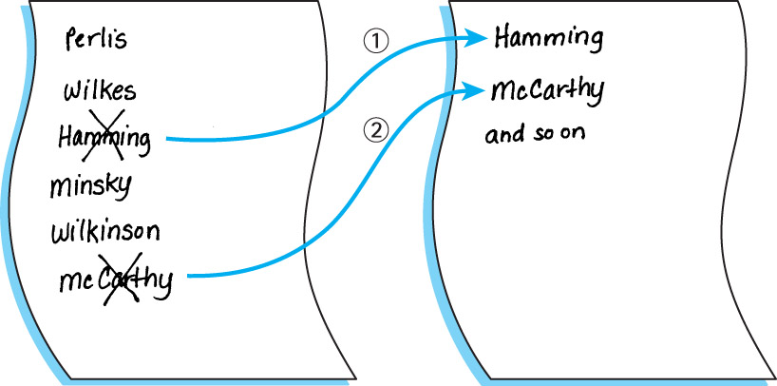
Selection Sort

Slide 11
An Improvement
Our algorithm is simple but it has one drawback: It requires space to store two complete lists (a separate sheet of paper on which to build the sorted list)
Instead of writing the “first” name onto a separate sheet of paper, we can exchange it with the name in the first location on the original sheet. And so on.
Using the pencil-and-paper analogy, all of the erasing and re-writing is inefficient, but that becomes a moot point when we’re reading and writing memory locations.

Slide 12
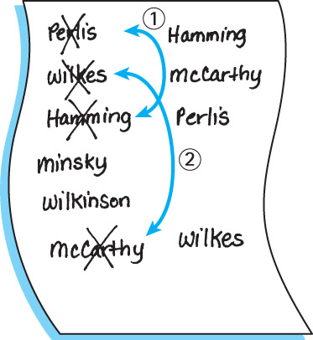
An Improvement

Slide 13
SelectionSort Algorithm - Pseudocode
SelectionSort
for current going from 0 to SIZE - 2
Find the index in the array of the smallest unsorted element
Swap the current element with the smallest unsorted one
An example is depicted on the following slide …

Slide 14
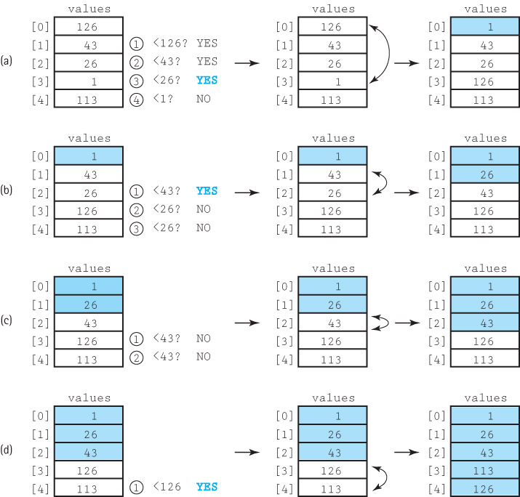
Selection Sort Algorithm - Example

Slide 15
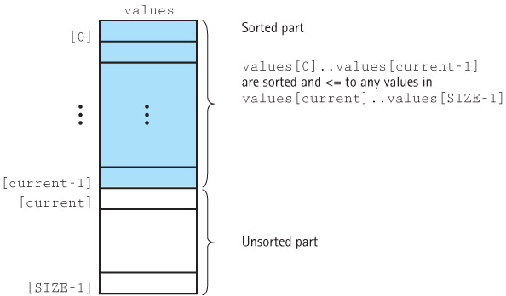
Selection Sort Snapshot

Slide 16
Selection Sort Code
static int minIndex(int startIndex, int endIndex)
// Returns index of the smallest value in values[startIndex]..values[endIndex]
{
int indexOfMin = startIndex; // Start w/assumption that first item is min
for (int index = startIndex+1; index <= endIndex; index++)
if (values[index] < values[indexOfMin]) // If we find a value smaller than
indexOfMin = index; // what we’ve seen, remember where
return indexOfMin;
}
static void selectionSort()
// Sorts the values array using the selection sort algorithm.
{
int endIndex = SIZE – 1;
for (int current = 0; current < endIndex; current++)
swap(current, minIndex(current, endIndex));
}

Slide 17
Testing Selection Sort
The resulting output:
the values array is:
92 66 38 17 21 78 10 43 69 19
17 96 29 19 77 24 47 01 97 91
13 33 84 93 49 85 09 54 13 06
21 21 93 49 67 42 25 29 05 74
96 82 26 25 11 74 03 76 29 10
values is sorted: false
Selection Sort called
the values array is:
01 03 05 06 09 10 10 11 13 13
17 17 19 19 21 21 21 24 25 25
26 29 29 29 33 38 42 43 47 49
49 54 66 67 69 74 74 76 77 78
82 84 85 91 92 93 93 96 96 97
values is sorted: true
The test framework:
initValues();
printValues();
System.out.println("values is sorted: " + isSorted());
System.out.println();
selectionSort();
System.out.println("Selection Sort called\n");
printValues();
System.out.println("values is sorted: " + isSorted());
System.out.println();

Slide 18
Selection Sort Analysis
We describe the number of comparisons as a function of the number of elements in the array, i.e., SIZE. To be concise, in this discussion we refer to SIZE as N
The minIndex method is called N – 1 times
Within minIndex, the number of comparisons varies:
in the first call there are N – 1 comparisons
in the next call there are N – 2 comparisons
and so on, until in the last call, when there is only 1 comparison
The total number of comparisons is (N – 1) + (N – 2) + (N – 3) + ... + 1
= N(N – 1)/2 = ½(N² – N)
Selection Sort performs O(N²) operations, so its time complexity is O(N²)

Slide 19
Selection Sort Analysis
Number of Comparisons required to sort arrays of different sizes using Selection Sort:
The number of swaps (exchanges) is N – 1 (each pass results in finding the smallest item and swapping it [once])
Number of Number of Elements (N) Comparisons (N(N – 1)/2)
10 45
20 190
100 4,950
1,000 499,500
10,000 49,995,000

Slide 20
Selection Sort Analysis
Number of Comparisons required to sort arrays of different sizes using Selection Sort:
The number of swaps (exchanges) is N – 1 (each pass results in finding the smallest item and swapping it [once])
Number of Number of Max Number of Elements (N) Comparisons (N(N – 1)/2) Swaps (N – 1)
10 45 9
20 190 19
100 4,950 99
1,000 499,500 999
10,000 49,995,000 9999

Slide 21
Bubble Sort
With this approach the smaller data values “bubble up” to the front of the array …
Each iteration puts the smallest unsorted element into its correct place, and may also make changes in the locations of some (or all) of the other elements in the array as it goes

Slide 22
Bubble Sort
The first iteration puts the smallest element in the array into the first array position:
Starting with the last array element, compare successive pairs of elements, swapping whenever the bottom element is smaller than the one above it
In this way the smallest element “bubbles up” to the top of the array.
The next iteration puts the smallest element in the unsorted part of the array into the second array position, using the same technique
The rest of the sorting process continues in the same way

Slide 23
BubbleSort Algorithm - Pseudocode
BubbleSort
Set current to the index of first element in the array
while there are more elements in the unsorted part of array
“Bubble up” the smallest element in the unsorted part,
causing intermediate swaps as needed
Shrink the unsorted part of the array by incrementing current
bubbleUp(startIndex, endIndex)
for index going from endIndex DOWNTO startIndex +1
if values[index] < values[index - 1]
Swap the value at index with the value at index - 1
An example is depicted on the following slide …

Slide 24
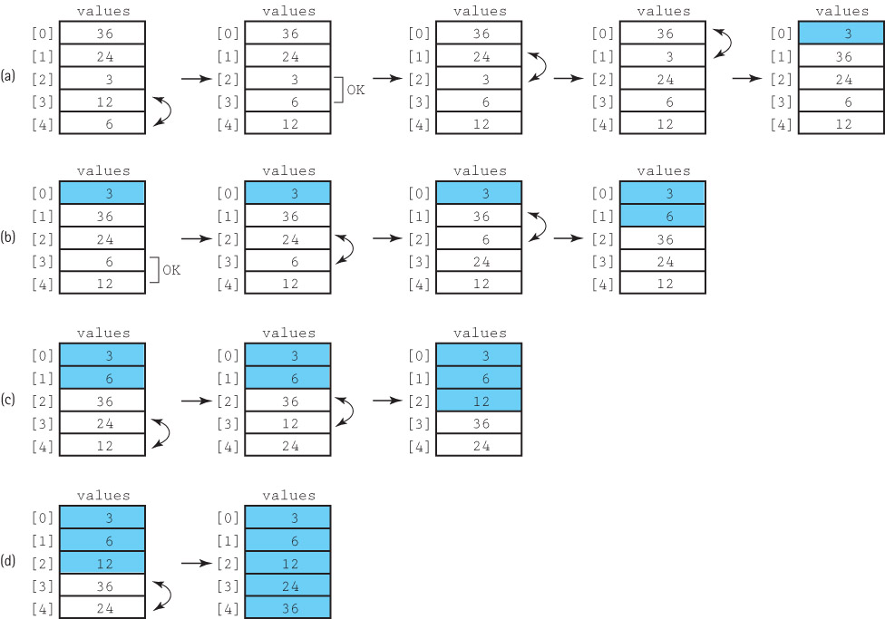
Bubble Sort Algorithm - Example

Slide 25
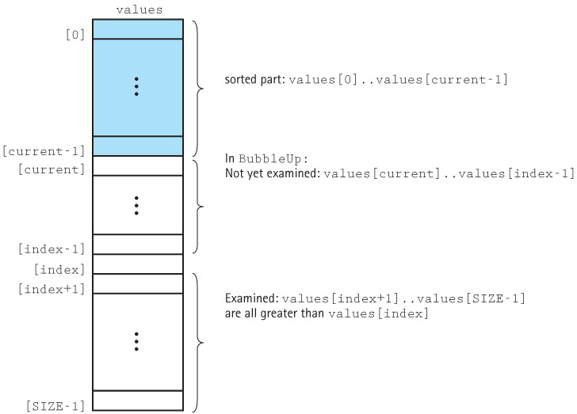
Bubble Sort Snapshot

Slide 26
Bubble Sort Code
static void bubbleUp(int startIndex, int endIndex)
{
// Switches adjacent pairs that are out of order between
// values[startIndex]..values[endIndex], beginning at values[endIndex].
for (int index = endIndex; index > startIndex; index--)
if (values[index] < values[index – 1]) // If the latter of the two should be
swap(index, index – 1); // the first of the two, swap them.
}
static void bubbleSort()
{
// Sorts the values array using the bubble sort algorithm.
int current = 0;
while (current < SIZE – 1)
{
bubbleUp(current, SIZE – 1);
current++;
}
}

Slide 27
Bubble Sort Code
static void bubbleUp(int startIndex, int endIndex)
{
// Switches adjacent pairs that are out of order between
// values[startIndex]..values[endIndex], beginning at values[endIndex].
for (int index = endIndex; index > startIndex; index--)
if (values[index] < values[index – 1]) // If the latter of the two should be
swap(index, index – 1); // the first of the two, swap them.
}
static void bubbleSort()
{
// Sorts the values array using the bubble sort algorithm.
for (int current = 0; current < SIZE – 1; current++)
bubbleUp(current, SIZE – 1);
}

Slide 28
Bubble Sort Analysis
Analyzing the work required by bubbleSort is the same as for the straight selectionSort algorithm.
The comparisons are in bubbleUp, which is called N – 1 times.
There are N – 1 comparisons the first time, N – 2 comparisons the second time, and so on.
Therefore, bubbleSort and selectionSort require the same amount of work in terms of the number of comparisons.
The Bubble Sort algorithm is O(N²)
Note, however, that there’s a 50-50 chance that each comparison leads to a swap, so there will also be O(N²) swaps, too.

Slide 29
Insertion Sort
In Chapter 6 (lists), we created a sorted list by inserting each new element into its appropriate place in an array. Insertion Sort uses the same approach for sorting an array.
Each successive element in the array to be sorted is inserted into its proper place with respect to the other, already sorted elements.

Slide 30
Insertion Sort
As with the previous sorts, we divide our array into a sorted part and an unsorted part.
Initially, the sorted portion contains only one element: the first element in the array.
Next we take the 2nd element in the array and put it into its correct place in the sorted part; i.e., values[0] and values[1] are in order relative to respect to each other.
Next the value in values[2] is put into its proper place, so values[0]..values[2] are in order with respect to each other. This process continues until all the elements have been sorted.

Slide 31
Insertion Sort Algorithm
insertionSort
for count going from 1 through SIZE – 1
InsertElement(0, count)
InsertElement(startIndex, endIndex)
Set finished to false
Set current to endIndex
Set moreToSearch to true
while moreToSearch AND not finished
if values[current] < values[current - 1]
swap(values[current], values[current - 1])
Decrement current
Set moreToSearch to (current ≠ startIndex)
else
Set finished to true
An example is depicted on the following slide …

Slide 32
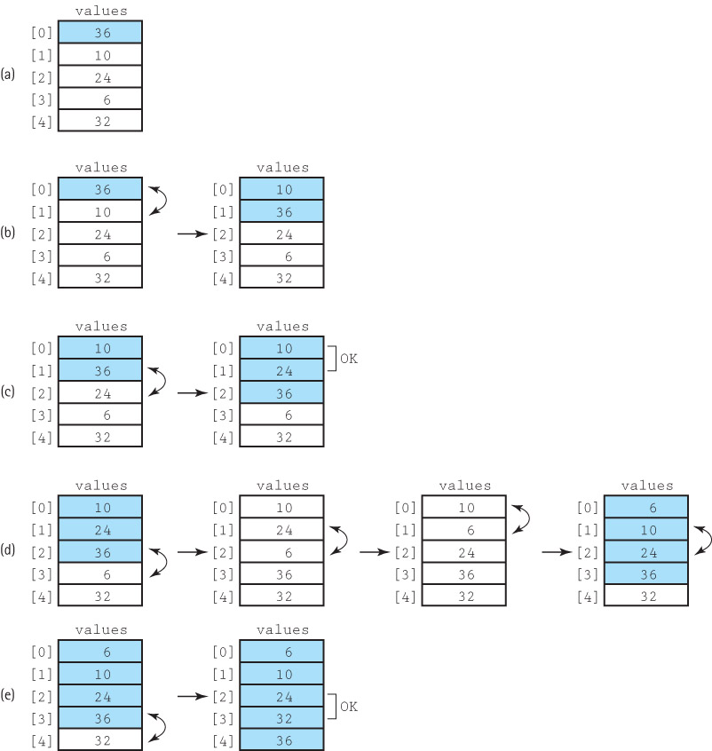
Insertion Sort Algorithm

Slide 33
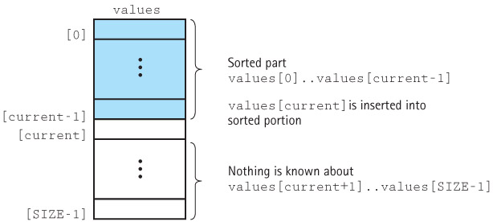
Insertion Sort Snapshot

Slide 34
Insertion Sort Code
static void insertElement(int startIndex, int endIndex)
{
// Upon completion, values[0]..values[endIndex] are sorted.
boolean finished = false;
int current = endIndex;
boolean moreToSearch = true;
while (moreToSearch && !finished)
{
if (values[current] < values[current – 1])
{
swap(current, current – 1);
current--;
moreToSearch = (current != startIndex);
}
else
finished = true;
}
}
static void insertionSort()
{
// Sorts the values array using the insertion sort algorithm.
for (int count = 1; count < SIZE; count++)
insertElement(0, count);
}

Slide 35
Insertion Sort Analysis
The general case for this algorithm mirrors the selectionSort and the bubbleSort, so the general case is O(N²).
But insertionSort has a “best” case: The data are already sorted in ascending order
insertElement is still called N times, but only one comparison is made each time and no swaps are necessary.
The maximum number of comparisons (and swaps) is made only when the elements in the array are in reverse order.

Slide 36
O(N log₂ N) Sorts (§10.3)
O(N²) sorts are very (prohibitively) time-consuming for sorting large arrays.
Two sorting methods that work better when N is large are presented in this section.
The efficiency of these algorithms is achieved at the expense of the simplicity we had in the selection, bubble, and insertion sorts.

Slide 37
List “Sortedness”
How do we measure the “sortedness” of a list?
Let’s say that our goal is to have {1, 2, 3, 4, 5} in increasing order
Clearly:
{1, 2, 3, 4, 5} is “perfectly sorted”
{1, 2, 3, 5, 4} is “almost sorted”
{1, 5, 2, 4, 3} is “less sorted”
{5, 3, 4, 1, 2} is “even less sorted”
{5, 4, 3 ,2 ,1} is “perfectly UNsorted”
So, the question remains: how do we measure the degree of “sortedness” in a list?

Slide 38
Sorting and Inversions
If the list is completely sorted, then A_{i} ≤ A_{i+1} ∀ i: 1 ≤ i ≤ (N – 1)
An inversion exists when an item in position i is > an item in position j and i < j
i.e., an item is to the left of some other item it should be to the right of
If the list is completely sorted, then there are no inversions
If the list is completely unsorted (i.e., in reverse order – the worst case), then how many inversions are there?

Slide 39
Sorting and Inversions
If we have 1 item, there can’t be any inversions
If we have 2 items, then there can only be either 0 or 1
{1, 2} – 0 inversions
{2, 1} – 1 inversion
If we have 3 items, then there can be 0 – 3 inversions:
{1, 2, 3} – 0 inversions
{1, 3, 2} – 1 inversion (3, 2)
{2, 3, 1} – 2 inversions (2, 1) and (3, 1)
{2, 1, 3} – 1 inversions (2, 1)
{3, 2, 1} – 3 inversions (3, 2), (2, 1), and (3, 1)
{3, 1, 2} – 2 inversions (3, 1), (3, 2)

Slide 40
Sorting and Inversions (2)
If we have 4 items:
There will be no inversions (0) if the list is sorted
If it’s exactly unsorted (i.e., reverse order), then we’ll have the maximum number of inversions:
{4, 3, 2, 1}
(4, 3), (4, 2), (4, 1) (3)
(3, 2), (3, 1) (2)
(2, 1) (1)
That’s 6 inversions (3 + 2 + 1)

Slide 41
Sorting and Inversions (3)
If we have 5 items:
There will be no inversions (0) if the list is sorted
If it’s exactly unsorted (i.e., reverse order), then we’ll have the maximum number of inversions:
{5, 4, 3, 2, 1}
(5, 4), (5, 3), (5, 2), (5,1) (4)
(4, 3), (4, 2), (4, 1) (3)
(3, 2), (3, 1) (2)
(2, 1) (1)
That’s 10 inversions (4 + 3 + 2 + 1)

Slide 42
Sorting and Inversions (4)
If we have 6 items:
There will be no inversions (0) if the list is sorted
If it’s exactly unsorted (i.e., reverse order), then we’ll have the maximum number of inversions:
{6, 5, 4, 3, 2, 1}
(6, 5), (6, 4), (6, 3), (6, 2), (6, 1) (5)
(5, 4), (5, 3), (5, 2), (5,1) (4)
(4, 3), (4, 2), (4, 1) (3)
(3, 2), (3, 1) (2)
(2, 1) (1)
That’s 15 inversions (5 + 4 + 3 + 2 + 1)

Slide 43
Sorting and Inversions (5)
For an arbitrary N, how many inversions can there be?
N items can have up to ½(N² – N) inversions
The O(N²) sorts ARE O(N²) because they have to do something (compare and/or swap) for every inversion, and there can be O(N²) inversions!
N | Worst Case | Max Inversions
1 | 0 | 0
2 | 1 | 1
3 | 1+2 | 3
4 | 1+2+3 | 6
5 | 1+2+3+4 | 10
6 | 1+2+3+4+5 | 15

Slide 44
Merge Sort
The sorting algorithms covered in Section 10.2 are all O(N²)
Note that N² is a lot larger than (½N)² + (½N)² = ½N²
If we can cut the array into two (equally-sized) pieces, sort each piece, and then merge the two back together, we should end up sorting the entire array with a lot less work
The sorting algorithms that run in less than O(N²) time are usually recursive (i.e., their strategy is to divide-and-conquer)
We’ll look into these in more depth in EECS 2510

Slide 45
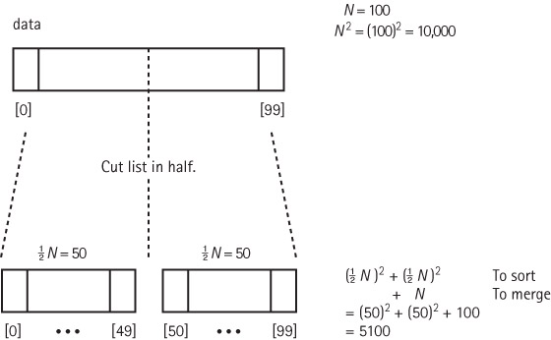
The Rationale For Divide & Conquer

Slide 46
Merge Sort Algorithm
mergeSort
Cut the array in half
Sort the left half (somehow – insertion / bubble / selection)
Sort the right half (somehow – insertion / bubble / selection)
Merge the two sorted halves into one sorted array
Because mergeSort is itself a sorting algorithm, why not use it to sort the two halves?
We can make mergeSort recursive and let it call itself to sort the two sub-arrays:
mergeSort—Recursive
Cut the array in half
mergeSort the left half
mergeSort the right half
Merge the two sorted halves into one sorted array

Slide 47
Merge Sort Summary
Method mergeSort(first, last)
Definition: Sorts array elements in ascending order
Size: last – first + 1
Base Case: If size is less than 2, do nothing.
General Case: Cut the array in half.
mergeSort the left half.
mergeSort the right half.
Merge the sorted halves into one sorted array.

Slide 48
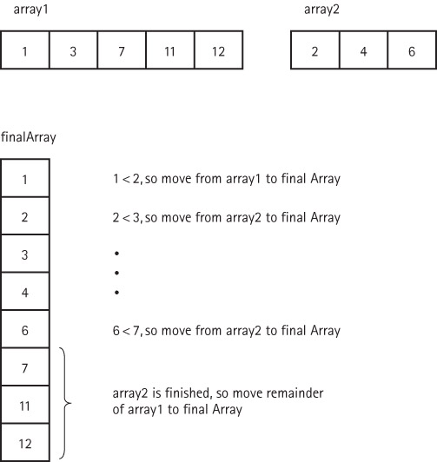
Merging Two Sorted Arrays

Slide 49
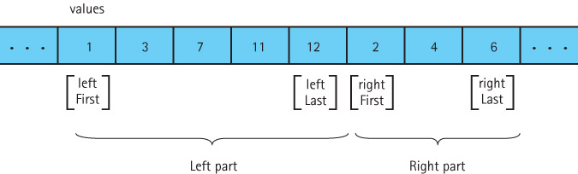
Our Actual Merge Problem

Slide 50
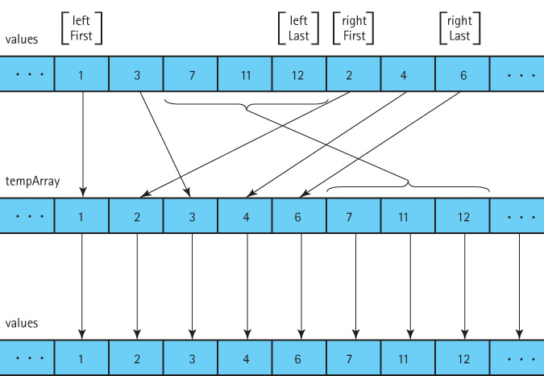
Our Solution

Slide 51
The merge Algorithm
merge (leftFirst, leftLast, rightFirst, rightLast)
(uses a local array, tempArray)
Set index to leftFirst
while more elements in left half AND more elements in right half
if values[leftFirst] < values[rightFirst]
set tempArray[index] to values[leftFirst]
Increment leftFirst
else
Set tempArray[index] to values[rightFirst]
Increment rightFirst
Increment index
Copy any remaining elements from left half to tempArray
Copy any remaining elements from right half to tempArray
Copy the sorted elements from tempArray back into values

Slide 52
The mergeSort Method (1)
The code for merge follows the algorithm on the previous slide.
It can be found on page 694-695 of the textbook.
merge does most of the work!

Slide 53
The mergeSort Method (2)
static void mergeSort(int first, int last)
{
// Sorts the values array using the mergeSort algorithm
if (first < last) // If there are at least 2 items,...
{
int middle = (first + last) / 2; // FIND the middle
mergeSort(first, middle); // mergeSort left half
mergeSort(middle + 1, last); // and right half
merge(first, middle, middle + 1, last); // put halves
} // together
}

Slide 54
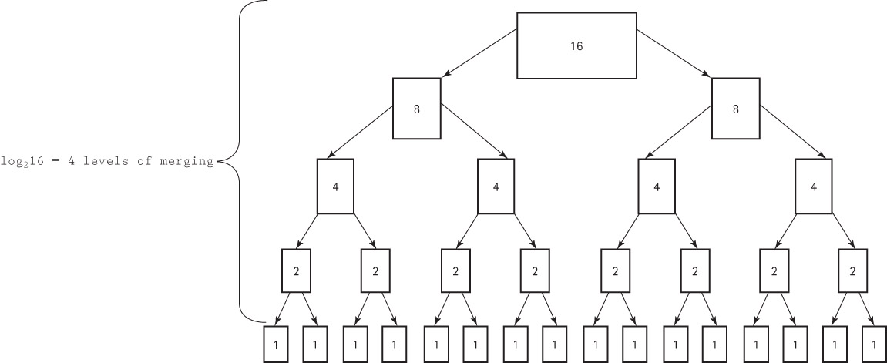
Analyzing mergeSort (1)

Slide 55
Analyzing mergeSort (2)
The total work needed to divide the array in half, over and over again until we reach subarrays of size 1, is O(N).
It takes O(N) total steps to perform merging at each “level” of merging.
The number of levels of merging is equal to the number of times we can split the original array in half
If the original array is size N, we have log₂(N) levels. (This is the same as the analysis of the binary search algorithm in Section 6.6.)

Slide 56
Analyzing mergeSort (3)
Because we have log₂(N) levels, and we require O(N) steps at each level, the total cost of the merge operation is: O(N log₂N)
Because the splitting phase was only O(N), we conclude that the performance of the mergeSort algorithm is O(N log₂ N).

Slide 57
N² vs. N log₂ N
N | log₂(N) | N² | N log₂ N | Savings
32 | 5 | 1,024 | 160 | 81.481%
64 | 6 | 4,096 | 384 | 89.655%
128 | 7 | 16,384 | 896 | 94.215%
256 | 8 | 65,536 | 2,048 | 96.774%
512 | 9 | 262,144 | 4,608 | 98.211%
1,024 | 10 | 1,048,576 | 10,240 | 99.014%
2,048 | 11 | 4,194,304 | 22,528 | 99.460%
4,096 | 12 | 16,777,216 | 49,152 | 99.706%
1,048,576 | 20 | 1,099,511,627,776 | 20,971,520 | 99.998%

Slide 58
Drawback of Merge Sort
A disadvantage of mergeSort is that it requires an auxiliary array that is as large as the original array to be sorted
If the array is large and space is a critical factor, this sort may not be an appropriate choice
Next we discuss two O(N log₂N) sorts that move elements around in the original array and do not need an auxiliary array
Such a sort is known as an in-place sort
Selection, Insertion, and Bubble are in-place sorts

Slide 59
? Questions ?
? Questions ?

